Slide 1
PRESENTATION PROJECT ON OPTIMUM HOUSING PRICE PREDICTION
PRESENTED BY:-
DIVYANSH SAHU (20BAI10363)
SHIVAM KABRA (20BAI10298)
RAJAT GORE (20BAI10184)
DIVYANSHU CHETAN (20BAI10129)
UNDER THE GUIDENCE OF:-
Mrs. Meenakshi Choudhary

Slide 2
CONTENT
INTRODUCTION
PROBLEM-STATEMENT
EXISTING SOLUTION
PROPOSED WORK
METHODOLOGY
SYSTEM ARCHITECURE.
PROJECT IMPLEMENTATION
NOVELTY
HARDWARE REQUIREMENTS
SOFTWARE REQUIREMENTS
REAL-TIME USAGE
MODEL DESCRIPTION AND WORK FLOW

Slide 3
INTRODUCTION
The optimal housing price prediction model is machine learning model which will predict price of any real estate or house given some basic details about the real estate such as number of bedrooms, plot size, neighbourhood details etc.

Slide 4
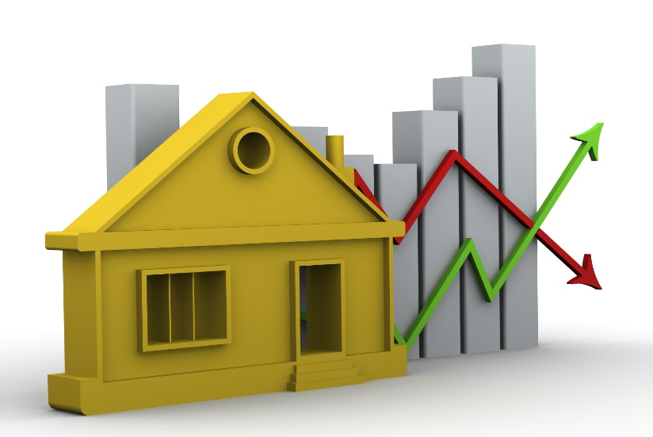
Problem-Statement
Prediction of real estate or house prices given its features

Slide 5
EXISTING Solution
Taking a latest dataset of housing prices which includes its features. Ex: Cost of a house is 35 Lakh, given its 2bhk with attached toilets, 1100 sqm in size etc.
Creating a machine learning model which will use this data set to train itself and predict the model according to the given output.

Slide 6
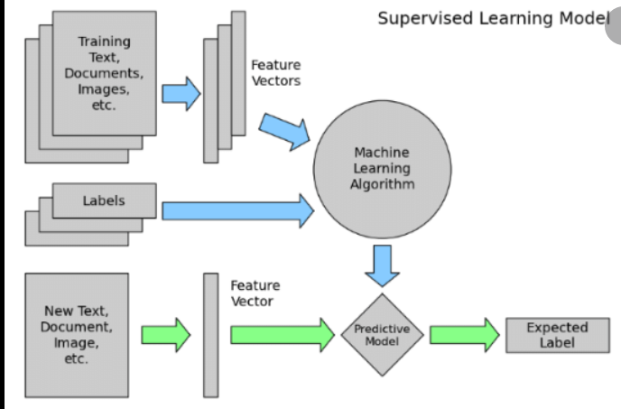
EXISTING WORK
Basic machine learning model with a smaller data sets.

Slide 7
PROPOSED WORK
Our proposal is to create a machine learning model to solve the problem.
The machine leaning model will train itself over a dataset and then will be able to predict the price of any house or real estate.
Graphs will be plotted so that everything is easily understandable.

Slide 8
Methodology
Use of supervised learning with regression on available dataset
Performance Measure which we will use is RMSE (Root Mean Square Error)
Supervised learning, also known as supervised machine learning, is a subcategory of machine learning and artificial intelligence. It is defined by its use of labelled datasets to train algorithms that to classify data or predict outcomes accurately. As input data is fed into the model, it adjusts its weights until the model has been fitted appropriately, which occurs as part of the cross-validation process.

Slide 9
SYSTEM ARCHITECTURE
DATA SET
ML MODEL
PREDICTED PRICE
FEATURES WE ENTER

Slide 10
PROJECT IMPLEMENTATION
1. Import the dependencies and libraries
import pandas
import numpy
sklearn - it is the machine learning library for python
linear_model from sklearn
train_test_split from sklearn.model_selection
(it is a function that splits our data into training and testing sets)
2. Now load the dataset for the particular location which you want to analyze. 3. Next step is to transform the dataset into the data frame. Create variable df_x and df_y.
4. Now get some statistics from the data set, count, mean, etc.
5. Initialize the linear regression model - reg = linear_model.LinearRegrssion()
6. Split the data into 80% as training and 20% as testing data.
7. Now train the model with our training data

Slide 11
8. Print the coefficients/weights for each feature/column of our model - print(reg.coef)
9. Now print the predictions on our test data.
10. Print the actual values - print(y_test)
11. Check the model performance using MSE (Mean Squared Error).
12. Now check the model performance using MSE and sklearn.metrics. Visualize the differences between the actual price and predicted price
Similarly, you can predict the house price of various locations by importing the data of the particular place. (You can get the data from the real-estate websites like 99acres, airbnb, homes.com, trulia, realtor, etc.
pandas- It is an open-source library written for python to perform data analysis and manipulation.
Matplotlib - It is a plotting library for python program and its mathematics extension NumPy.
NumPy - It is a package for python for scientific computing to perform different operations.
sklearn/scikit-learn - It is a free machine learning library developed for python programming language under BSD license which is majorly used for data analysis and data mining. It also supports various machine learning algorithms such as SVM, random forests, k-neighbours, etc.

Slide 12
Novelty
Our project not only calculates price of a real estate based on its basic features but also on the basis of the location, calculating the number of necessities in the area chosen.

Slide 13
HARDWARE REQUIREMENTS (PREFERABLE)
INTERNET CONNECTIVITY
8GB-16GB RAM
4GB-6GB Graphics card (NVIDIA GPU)
1TB-2TB Hard disk AND 500GB -1TB SSD
8th generation (Intel Core i7 processor)

Slide 14
SOFTWARE REQUIREMENTS -
JUPYTER NOTEBOOK,
VISUAL STUDIO CODE
PYTHON IDE
NUMPY LIBRARY MODULE
PANDAS LIBRARY MODULE
GITHUB.

Slide 15
REAL TIME USAGE
If a person wants to buy or sell or rent a house, he/she can just enter some basic details/features and the model will predict the price for them.

Slide 16
Module description and work flow
First we load the data set from the UCI Boston Housing repository using Pandas library.
Then we check the description and the information of the Data which was loaded
After this we split our data into train set and Test set.
Just to understand the data we will be using Matplotlib Library.
We will also be seeing the Correlations between the label and features.
We will also try to create a new attribute combination and check it using co-relations

Slide 17
We will also be using the Imputer class for automating the algorithm if there are null values in the DATA set
Then we would use a standard scaler to bring all the values of the data set within the numbers 0 and 1
Then we will train our data using Linear Regression which is present as a function in the SCI-KIT learn library
Using sample inputs we will check the Root mean squared error on the training data prediction to check for over-fitting or under-fitting of the train set.
Then we will run the algorithm on the Test set and again check for Root mean squared error, R^2 value, Accuracy, adjusted R^2 value.
After evaluating the results we would check the model by providing a 2-D numpy array and checking the Price prediction.

Slide 18
THANK YOU !!!!

